Slide 1
PLM System Demo ECATS – ECAD CIS CPaM & Teamcenter Part Library Synchronization (An Automated End-to-End Solution) 1st Sep 2023 Sanjeev Beemidi

Slide 2
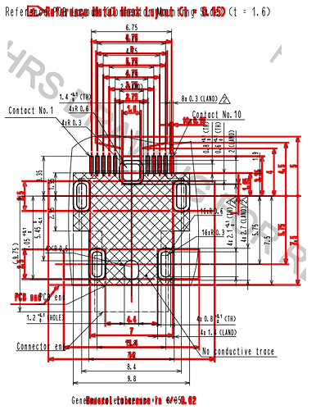








High-level Overview of Part Release Process
Synchronization
(Manual)
Request Raised for Pre-Release Approval
Approvals by Different Stakeholders
VLS
(Virtual Library System)
CPaM
(CIS Part Manager –web app)
(Formerly CIS Omnify)
Staging Dir
Teamcenter
Creates a Record in CPaM database’s table
[UpdateCISInfoToTc_Log]
CPaM Scheduler
(that updates Timestamp and copy into Staging)
With ROWID, ITEM ID

Slide 3


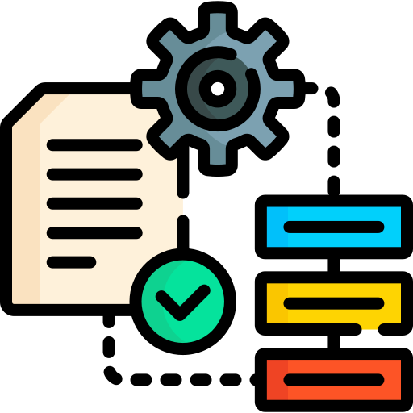
Technical Architecture of Automated CIS-CPaM to Teamcenter
for Pre-Released Parts
CIS Library Import Tool
Input File
(Capacitors)
Status Database tracking the Parts Update in Teamcenter
STAGING
Directory
3
Execution, Reports, Runtime Visibility
Input File
(Resistors)
CRON JOB
Polling
5
Status Table Updated
Input File
(Diodes)
2
Pre-Process to verify and validate the format and contents
Tc SOA
Input File
(Transistors)
4
EDA Parts Regularly
Updated
Input File
– existing CIS library migration
Synchronization of Parts from CIS to Teamcenter
1
Input files of different item types
Automated CIS Part Library Synchronization with Teamcenter
Notes:
The CIS Library is the authorship and source of truth for electrical board components. An automated utility to transfer CIS Library SQL Data to Teamcenter will facilitate keeping the part data up to date and accurate in Teamcenter, for use in ECAD BOMs and downstream systems. [The tool can be used for bulk updates and for one-off new components added to CIS. To be used by MITC librarians.]

Slide 4
DEMO
Use Case 1: End-to-End Automation
CIS SYSTEM→ CIS AUTOMATION → Teamcenter
Use Case 2: New Items, CREATE/CLASSIFY
Use Case 3: Existing ITEMS – SKIP/MODIFY AS APPROPRIATE
Use Case 4: RELEASE ITEMS – STILL CLASSIFIED, RETAIN OWNERSHIP.
Q&A

